Slide 1

Session Name:
The Simplex Method for LP Optimization
Delivered By:
Mr. Ritwik Sinha

Slide 2

Linear Programming
The Simplex Method is a powerful iterative algorithm used to solve Linear Programming Problems (LPPs) efficiently. It finds the optimal solution by moving along the edges of the feasible region in a stepwise manner.
Iterative process in Simplex method:
Identify the entering variable (most negative coefficient in the objective row).
Identify the leaving variable (smallest positive ratio in RHS).
Perform pivoting (row operations) to update the Simplex Table.
Repeat until no more negative coefficients exist in the objective row.

Slide 3

Learning Objectives
By the end of this session, you will be able to:
Define steps involved in Simplex Method
Solve different steps with an example
Python implementation of Simplex Method

Slide 4

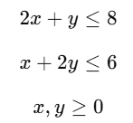
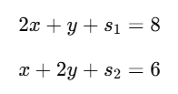

Step – 1: Using LPP problem, convert constraints into equations
Maximize -
Subject to –
Since inequalities are not directly solvable, introduce slack variable s1 and s2 to convert inequalities into equations:-
Final objective function -

Slide 5
Step – 2: Set Up the Initial Simplex Tableau
Basis | X | y | S1 | S2 | RHS
S1 | 2 | 1 | 1 | 0 | 8
S2 | 1 | 2 | 0 | 1 | 6
Z row | -3 | -5 | 0 | 0 | 0
Key Components:
Rows: Represent constraints
Columns: Represent variables 𝑥,𝑦,𝑠1,𝑠2
RHS (Right-Hand Side): Represents resource availability
Z row: Contains coefficients of the objective function

Slide 6
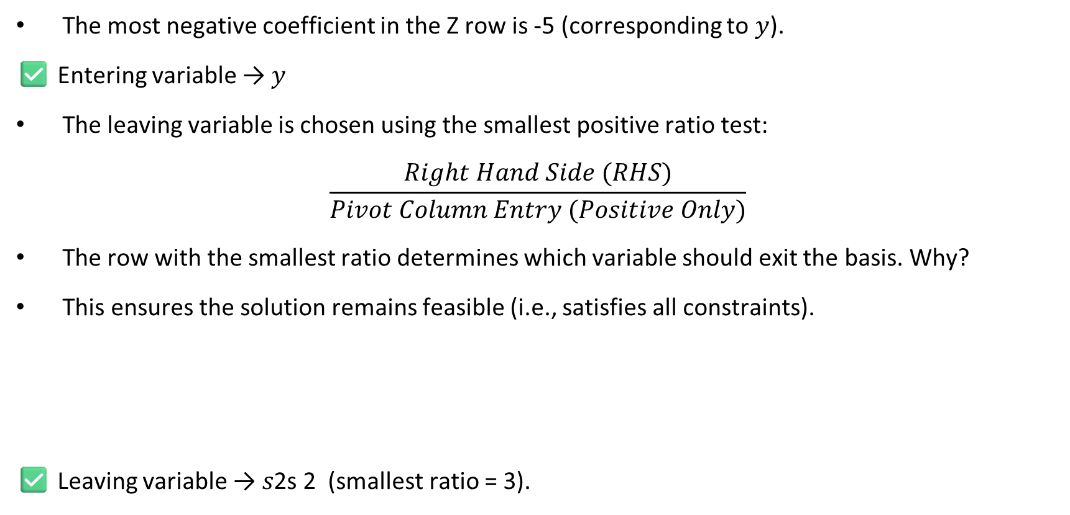
Step 3&4: Identify the Entering Variable | Identify Leaving Variable
The most negative coefficient in the Z row is -5 (corresponding to 𝑦).
✅ Entering variable → 𝑦
The leaving variable is chosen using the smallest positive ratio test:
$$\frac{Right Hand Side (RHS)}{Pivot Column Entry (Positive Only)}$$
The row with the smallest ratio determines which variable should exit the basis. Why?
This ensures the solution remains feasible (i.e., satisfies all constraints).
✅ Leaving variable → 𝑠2s 2​ (smallest ratio = 3).
Row | Calculation | Ratio
S1 | 8/1 | 8
S2 | 6/2 | 3

Slide 7
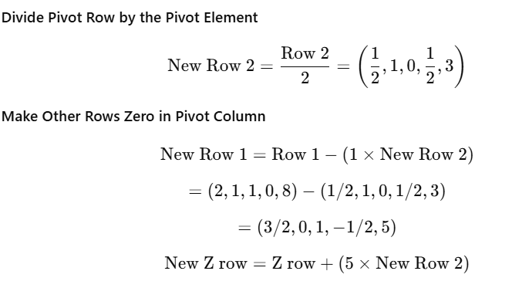
Step 5: Pivoting
The pivot element is 2 (intersection of entering variable 𝑦 and leaving variable 𝑠2).We perform row operations to make this column a unit column.

Slide 8
Step 6: Repeat Until No Negative Values in Z Row
Continue choosing entering and leaving variables and performing pivoting until the Z row has no negative values.
After another iteration, we obtain:
✅ Optimal Solution → 𝑥=2, 𝑦=3
✅ Maximum Value of Z → 21

Slide 9
Academic Poll
In the Simplex Method, how do we identify the entering variable?
A) The variable with the most positive coefficient in the objective function row B) The variable with the most negative coefficient in the objective function row C) The variable with the smallest absolute value in the constraint matrix D) The variable with the highest coefficient in any constraint
What is the purpose of the minimum ratio test in the Simplex Method?
A) To determine which variable should enter the basis B) To decide the optimal value of the objective function C) To identify which variable should leave the basis D) To check if the solution is feasible

Slide 10
Academic Poll
In the Simplex Method, how do we identify the entering variable?
A) The variable with the most positive coefficient in the objective function row B) The variable with the most negative coefficient in the objective function row C) The variable with the smallest absolute value in the constraint matrix D) The variable with the highest coefficient in any constraint
What is the purpose of the minimum ratio test in the Simplex Method?
A) To determine which variable should enter the basis B) To decide the optimal value of the objective function C) To identify which variable should leave the basis D) To check if the solution is feasible

Slide 11
Academic Poll
Which condition indicates that the optimal solution has been reached in the Simplex Method?
A) All elements in the last row (objective function row) are non-negative B) The tableau contains a row with all zero values C) The pivot column has all negative values D) The right-hand side (RHS) contains only negative values
What happens if there is no feasible solution in the Simplex Method?
A) The algorithm continues indefinitely B) The objective function value remains constant C) The tableau contains a row with a negative RHS and all non-positive coefficients D) The method selects a random solution

Slide 12
Academic Poll
Which condition indicates that the optimal solution has been reached in the Simplex Method?
A) All elements in the last row (objective function row) are non-negative B) The tableau contains a row with all zero values C) The pivot column has all negative values D) The right-hand side (RHS) contains only negative values
What happens if there is no feasible solution in the Simplex Method?
A) The algorithm continues indefinitely B) The objective function value remains constant C) The tableau contains a row with a negative RHS and all non-positive coefficients D) The method selects a random solution

Slide 13
Session Summary
In this session, we have discussed about:
Different steps involved in solving LPP using Simplex Method
Implementing these steps in Python

Slide 14

Happy Learning!

